Slide 1

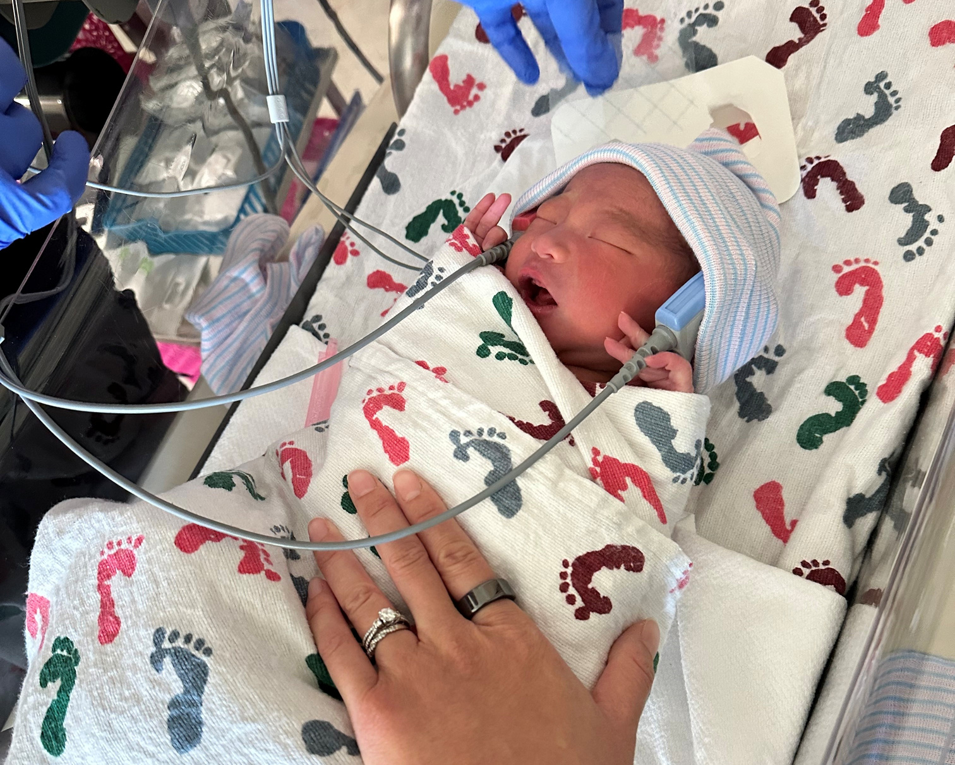

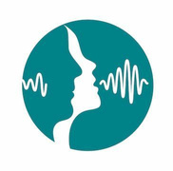
Role of Audiologists and SLPs in the Early Hearing Detection and Intervention (EHDI) System
Name, Credentials
Job Title/Company

Slide 2
Presenter Disclosures
Financial Disclosures
Non-Financial Disclosures
[Write in financial disclosures]
[Write in non-financial disclosures]
Name and Credentials

Slide 3

AGENDA FOR TODAY
01
What Is EHDI?
02
What Are the 1-3-6 Benchmarks?
03
Role of the Audiologist in the EHDI System
04
Role of the SLP in the EHDI system
05
Fact or Fiction?
06
Hearing and Speech Development Milestones
07
How To Find the Right Provider for Your Referral

Slide 4
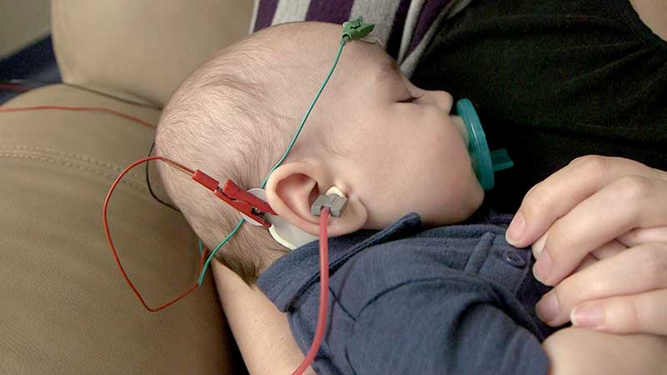
What is EHDI?
EHDI stands for Early Hearing Detection and Intervention — the nationwide effort to
identify hearing loss in newborns and infants as early as possible and
provide timely intervention.
The goal is to ensure that children who are born deaf or hard of hearing receive appropriate support and services to optimize their communication skills and overall development.

Slide 5
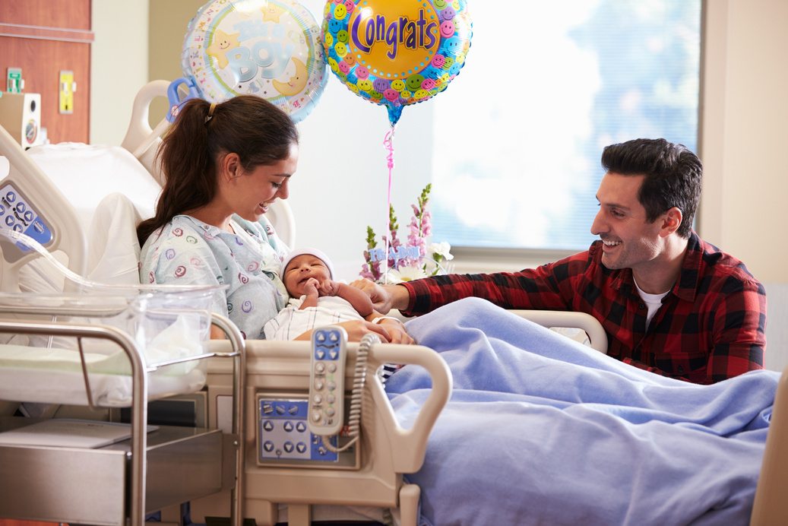
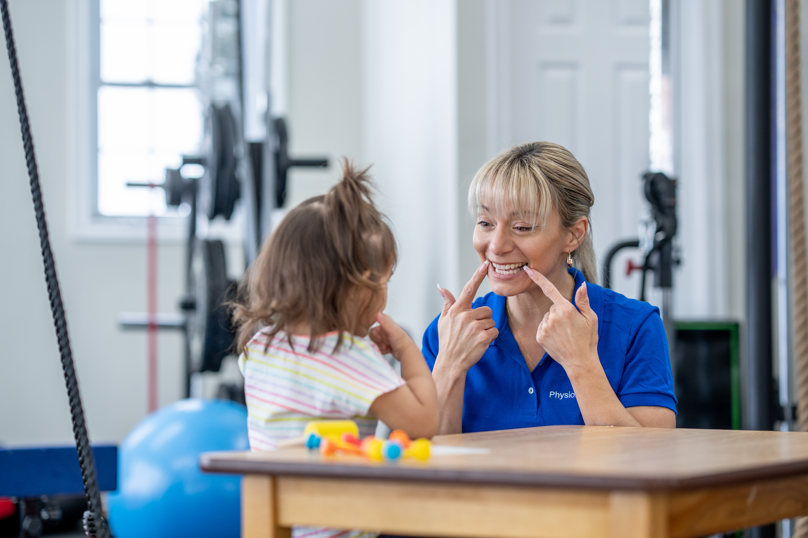
What Are the 1-3-6 Benchmarks?
In 2007, the Joint Commission on Infant Hearing (JCIH) established specific guidelines to ensure that newborns and infants who are deaf or hard of hearing are identified as early as possible and receive appropriate interventions in a timely manner. These benchmarks help measure the effectiveness and efficiency of EHDI programs.
1 Month
3 Months
6 Months
Newborn Hearing Screening
Usually performed before discharge from the hospital.
Can also be completed at a clinic or a community health center if baby was not born at a hospital.
Diagnose Hearing Loss
Babies who refer on their newborn hearing screening should see an audiologist for a diagnostic evaluation.
Audiologist will determine how well the baby hears in each ear.
Enroll in Early Intervention (EI)
EI can include
fitting of hearing devices (e.g., hearing aids, CIs)
services (e.g., speech and language therapy)
family-to-family support programs.

Slide 6







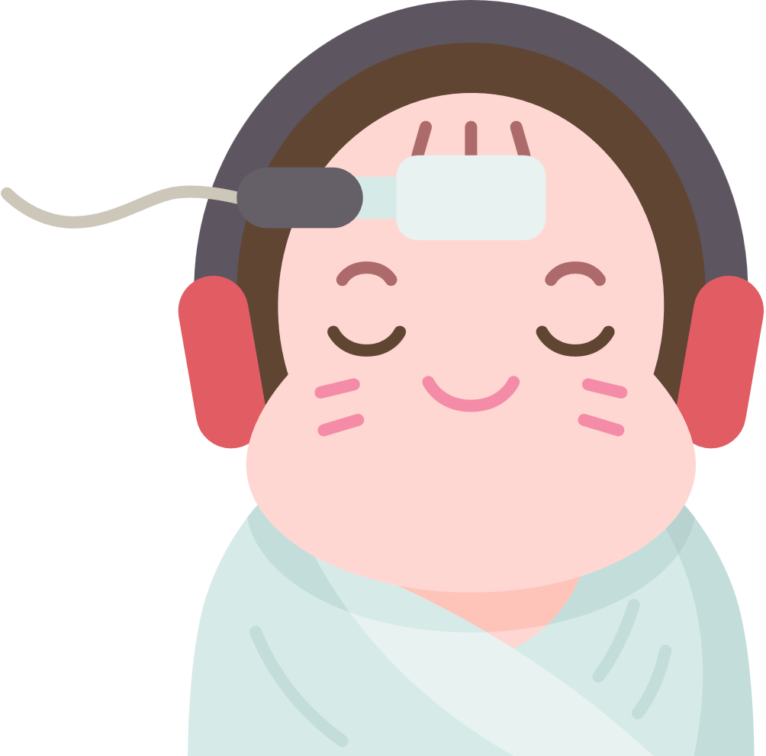




Role of the Audiologist in the EHDI System
Follow-Up
After diagnosing a hearing loss, the audiologist sees the patient regularly (frequency of follow-up depends on the clinic’s protocol).
Babies grow quickly, and so do their ears! The different parts on a hearing device are constantly monitored to ensure that they keep up with baby’s growth.
Diagnosis of Hearing Loss
Completes a comprehensive hearing evaluation for a baby.
Determines how a baby hears in each ear for all frequencies important for speech.
Newborn Hearing Screening
Early Intervention
Refers babies to early intervention in their state.
Fits babies with proper hearing devices, depending on each baby’s hearing level.
Refers babies to family-to-family support services for children who are deaf or hard of hearing.
Manages newborn hearing screening programs.
Trains hearing screeners.
Some audiologists are EHDI Coordinators for their state.
Advocacy
Keeps up with EHDI state and federal policy.
Reminds community and elected reps why EHDI is important.

Slide 7


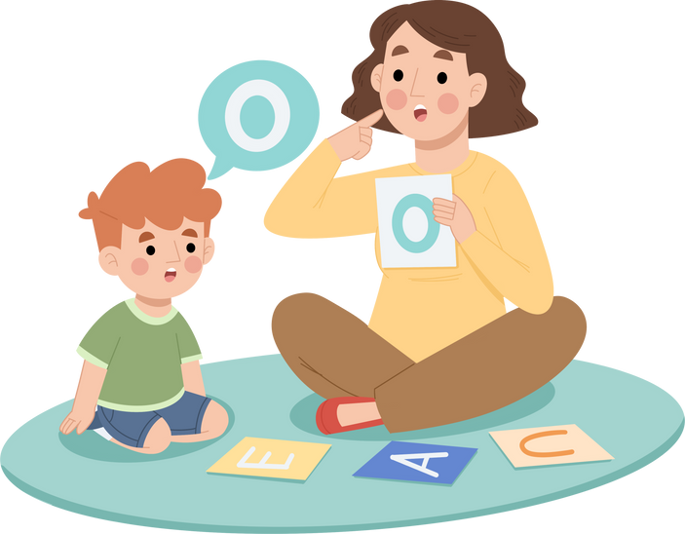
Role of the SLP in the EHDI System
Ensuring Proper Diagnosis From an Audiologist
Early Intervention
Once hearing loss is confirmed, the SLP helps implement the individualized treatment plan for the child.
This can involve speech therapy, hearing device support, family education, and collaboration with the EHDI team.
Confirms that a diagnostic evaluation was done by an audiologist if a baby refers on their newborn hearing screening.
Connects families to an audiologist if evaluation is still pending.
Newborn Hearing Screening
Diagnosis and Assessment
(Communication Delays)
Makes sure to ask if a child on their caseload has received a newborn hearing screening.
Some SLPs receive specialty training to perform newborn hearing screenings.
Advocacy
Assesses children who have been diagnosed with hearing loss or who show signs of communication delays.
This means using observation, interview, and criterion-referenced assessments to look at speech, language, social communication, and overall development.
Keeps up with EHDI state and federal policy.
Reminds community and elected reps why EHDI is important.

Slide 8
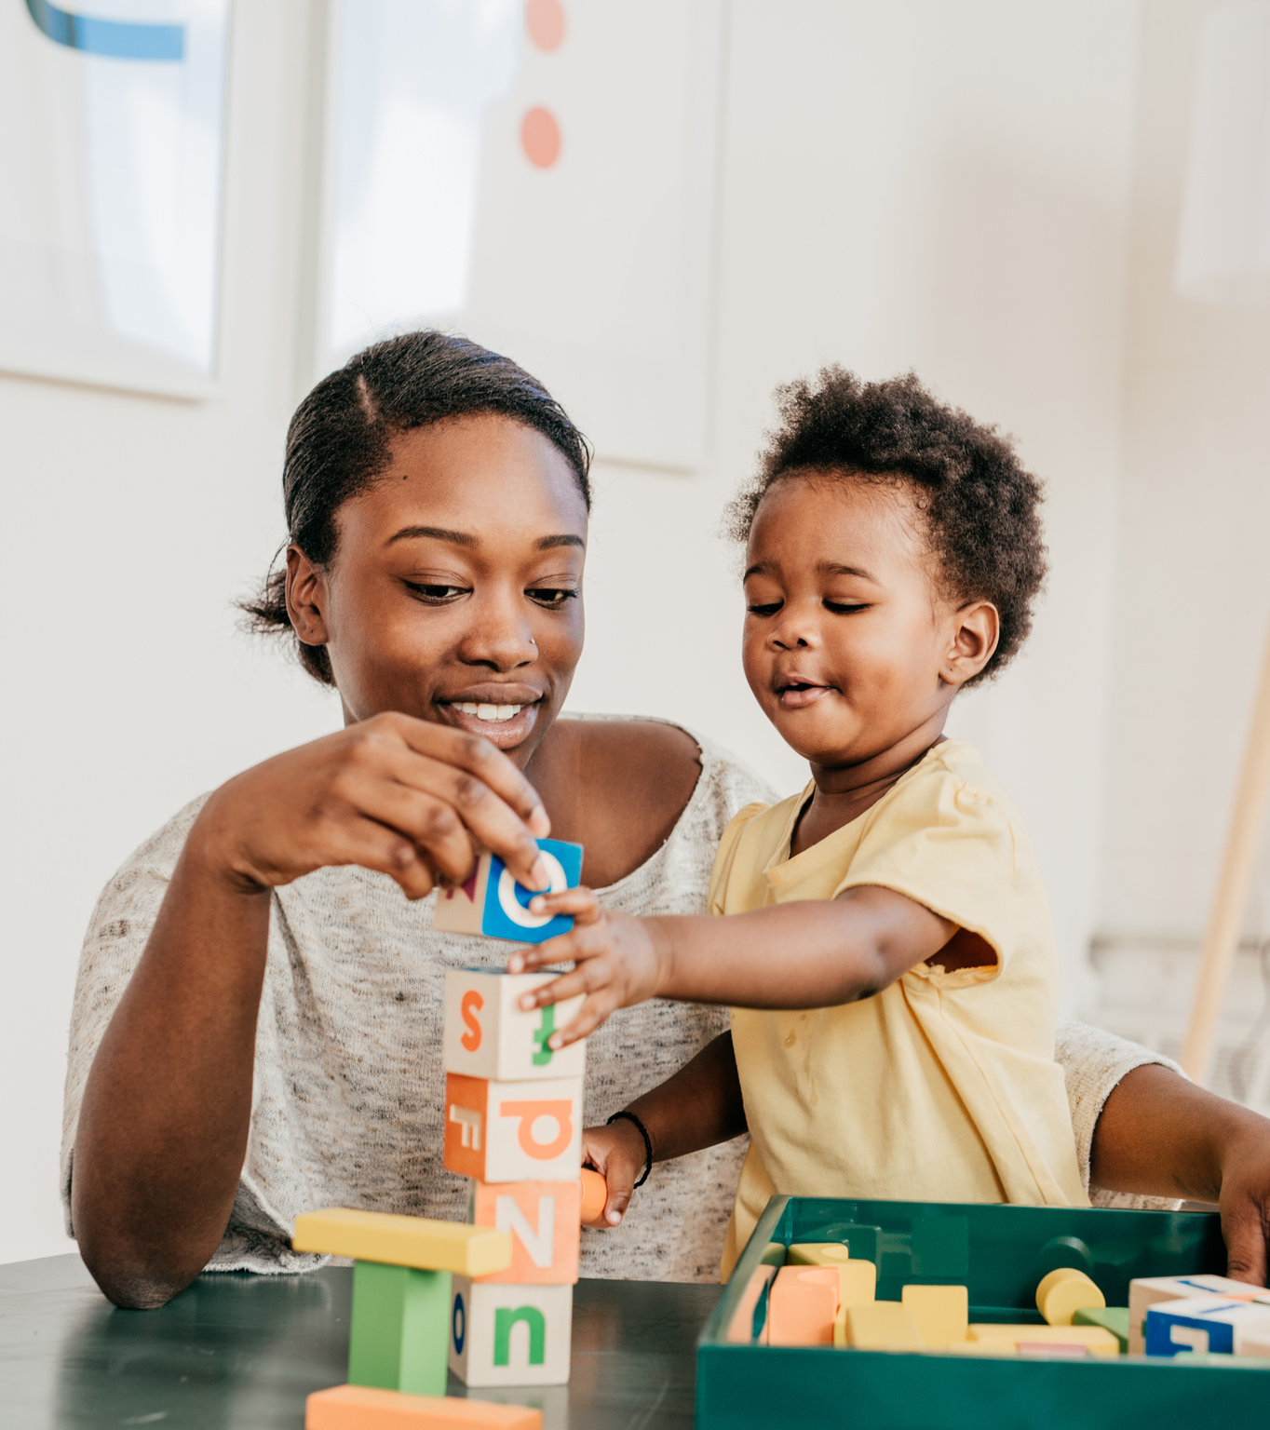
Fact or Fiction?
Read the following statements. Decide if they are fact or fiction.
If a baby passes their newborn hearing screening, then they will have typical hearing for the remainder of their childhood.
Some SLPs are specially trained to work with kids who are deaf and hard of hearing on auditory-verbal practice.
Hearing aids that are fit early are the only thing a baby needs to successfully communicate in early childhood.
Evidence shows that family-to-family support improves outcomes for children who are deaf and hard of hearing.
Each individual statement is discussed in more depth
on the slides that follow.

Slide 9
Fact or Fiction?
Let’s look at Statement #1:
1. If a baby passes their newborn hearing screening, then they will have typical hearing for the remainder of their childhood.
× FICTION: Hearing loss can occur anytime across the lifespan.
Even a baby who passes their newborn hearing screening can develop hearing loss at any point in childhood. Be vigilant!
If there are concerns about hearing, make sure that the family gets the child’s hearing checked by an audiologist.

Slide 10
Fact or Fiction?
Let’s look at Statement #2:
2. Some SLPs are specially trained to work with kids who are deaf and hard of hearing on auditory-verbal practice.
✓ FACT: SLPs can complete specialized training and take an exam to become a Listening and Spoken Language Specialist (LSLS).
The AG Bell Academy manages this specialty certification.

Slide 11
Fact or Fiction?
Let’s look at Statement #3:
3. Hearing aids that are fit early are the only thing a baby needs to successfully communicate in early childhood.
× FICTION: Although hearing aid fitting is an important step that families can take to give a child auditory access, other aspects also impact successful communication in early childhood:
making sure that hearing aids and ear molds fit properly
enrolling in speech therapy
receiving family-to-family support

Slide 12
Fact or Fiction?
Let’s look at Statement #4:
4. Evidence shows that family-to-family support improves outcomes for children who are deaf and hard of hearing.
✓ FACT: Family-to-family support for children who are deaf or hard of hearing can significantly impact their development and well-being.
It helps parents navigate the emotional and practical challenges, connect with other families, and learn effective strategies.
It leads to improved language acquisition, enhanced communication skills, and a stronger sense of self-esteem for the child.

Slide 13
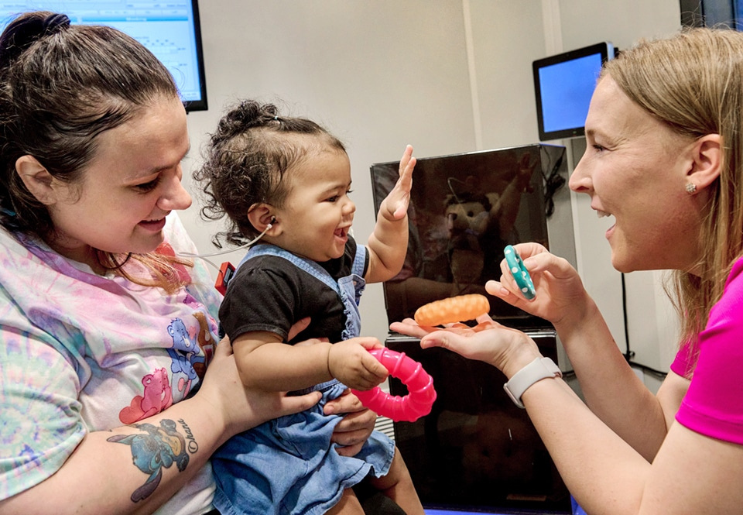
Hearing and Speech
Development Milestones
Hearing loss can be harder to spot in infants and toddlers — for several reasons:
Their wake windows can be limited.
Their motor skills are still developing.
They don’t have the language to tell their parents that they can’t hear something.
To help spot hearing loss in infants and toddlers,
it’s helpful to understand hearing and speech development milestones.
Here they are, broken down by age range (see next several slides).

Slide 14
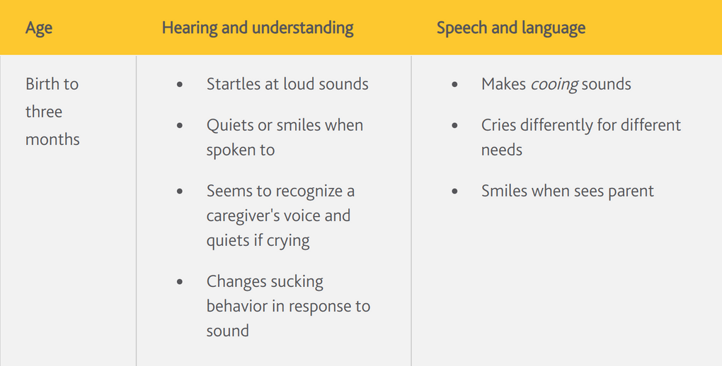
Hearing and Speech
Development Milestones (cont’d)
Source: Cochlear
The inclusion of outside programs, products, or services is for educational purposes only and does not indicate an endorsement by ASHA.

Slide 15
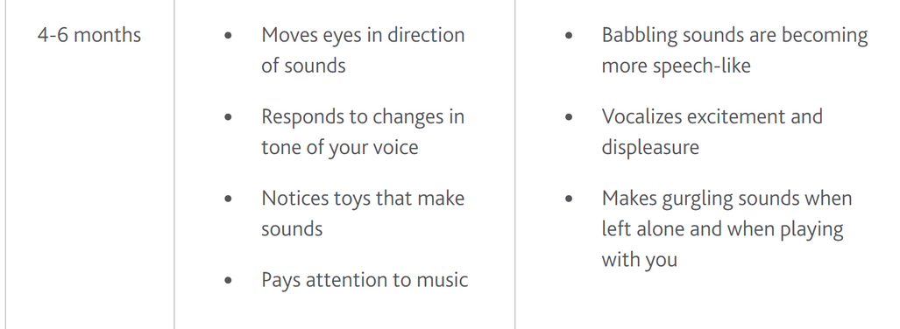
Hearing and Speech
Development Milestones (cont’d)
Source: Cochlear
The inclusion of outside programs, products, or services is for educational purposes only and does not indicate an endorsement by ASHA.

Slide 16

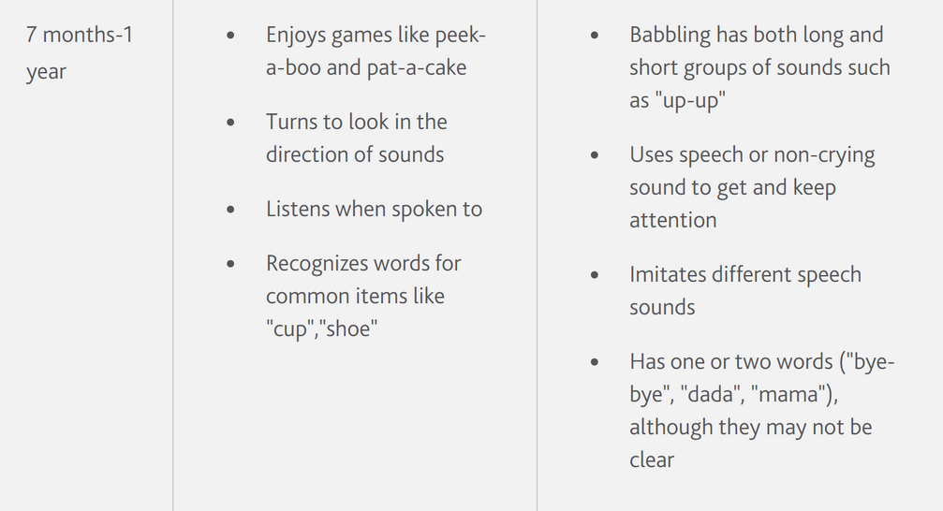
Hearing and Speech
Development Milestones (cont’d)
If you have concerns that a child may be falling behind on their milestones, refer the child for a hearing evaluation by an audiologist!
Source: Cochlear
The inclusion of outside programs, products, or services is for educational purposes only and does not indicate an endorsement by ASHA

Slide 17
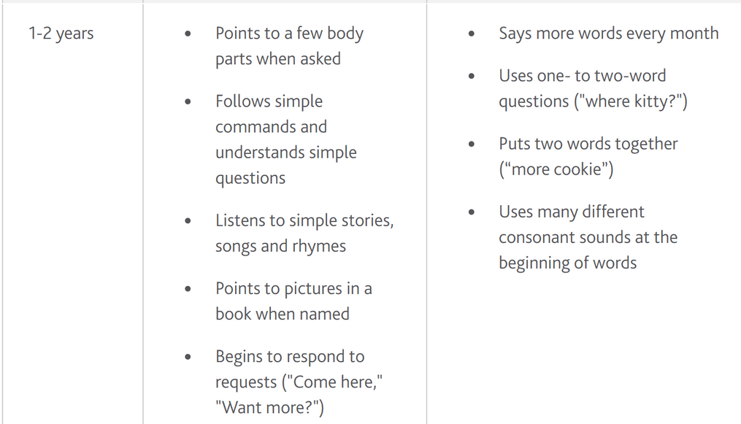
Hearing and Speech
Development Milestones (cont’d)
If you have concerns that a child may be falling behind on their milestones, refer the child for a hearing evaluation by an audiologist!
Source: Cochlear
The inclusion of outside programs, products, or services is for educational purposes only and does not indicate an endorsement by ASHA.

Slide 18





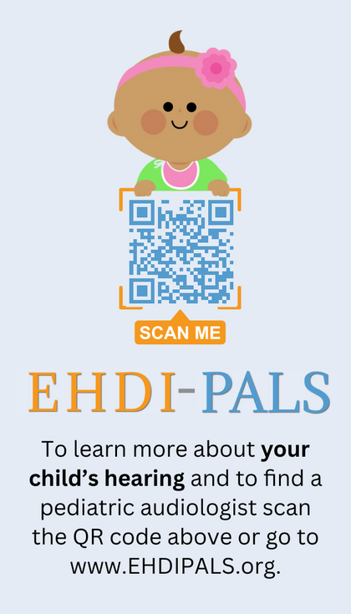


I need to refer an infant or toddler to see an audiologist or an SLP: Where do I go?
Ask Your State EHDI Coordinator
ASHA ProFind
Identify an ASHA-certified audiologist or SLP in your area by using ASHA’s online directory:
↓
NCHAM keeps an updated list of EHDI coordinators who will be very familiar with the providers in your state:
↓
www.asha.org/profind
www.infanthearing.org

Slide 19

Thanks
FOR ALL YOU DO!
QUESTIONS?
[Insert email here]

