Slide 1
Instructions for Customizing This Presentation
Adjust the slide background to match your preferences or your organization’s branding.
Add images or videos to enhance engagement.
Modify fonts, colors, and layouts for readability and consistency.
Ensure accessibility by using high-contrast colors and alt text for images.
Add or remove slides as needed to tailor your presentation.
Save and share in the preferred format (e.g., PPTX, PDF) for easy access.

Slide 2
Adult Speech-Language Pathology Services in Health Care Settings
Inservice Presentation

Slide 3
Agenda
Role of the Speech-Language Pathologist (SLP)
Populations Whom SLPs Serve
Health Care Settings
Swallowing and Swallowing Disorders
Cognition, Speech, Language, and Voice
Aerodigestive Disorders
When To Consult an SLP

Slide 4
Role of the Speech-Language Pathologist (SLP)
The SLP’s role is to
  maximize communication, thinking, and safe swallowing function;
  perform screening and comprehensive evaluations; and
  provide individualized treatment that aligns with the patient’s or client’s goals.

Slide 5
Populations Whom SLPs Serve
SLPs serve individuals who have difficulty with communication, thinking, or swallowing.
SLPs are commonly consulted in patients with
  neurological conditions (e.g., stroke, traumatic brain injury, multiple sclerosis, Parkinson’s disease);
  medical/surgical events (e.g., surgery to head/neck, endotracheal intubation);
  chronic conditions (e.g., chronic obstructive pulmonary disease); and
  developmental or congenital conditions (e.g., cerebral palsy).

Slide 6
Health Care Settings
SLPs help patients throughout the continuum of care in a variety of settings:
hospital (acute care)
acute rehabilitation
outpatient rehabilitation
skilled nursing facility (SNF)
long-term care (LTC)
long-term acute-care hospital (LTACH)
assisted living facility
continuing care retirement community
home health

Slide 7
Swallowing and Swallowing Disorders
SLPs screen, evaluate, diagnose, and treat swallowing disorders to support safe, effective, and dignified eating and drinking across the lifespan.
The following information describes normal swallowing and swallowing disorders (dysphagia).

Slide 8
Normal Swallowing
Swallowing is a complex, coordinated process that moves food, liquid, and saliva from the mouth to the stomach. It involves 3 phases:
  Oral phase: Containing food/liquid/saliva in the mouth, chewing, and moving food/liquid to the back of the mouth
  Pharyngeal phase: Moving food/liquid/saliva through the throat, protecting the airway, and clearing residue from the throat
  Esophageal phase: Moving food/liquid/saliva through the food pipe, down to the stomach

Slide 9
Normal Swallowing (cont’d)
[NOTE TO PRESENTER: Consider inserting a video demonstrating normal swallowing on VFSS/MBSS here. Examples:
Normal Swallow
Swallow Study - Solid Texture/Cracker - Modified Barium Swallow Study (MBSS) Lateral View HD]

Slide 10
Swallowing Disorders (Dysphagia)
Dysphagia is a swallowing disorder involving the oral cavity, pharynx, esophagus, or gastroesophageal junction.
Dysphagia can have the following consequences:
  malnutrition
  dehydration
  aspiration pneumonia
  compromised general health
  chronic lung disease
  choking
  death
Adults with dysphagia may also experience disinterest, reduced enjoyment, embarrassment, and/or isolation related to eating or drinking.

Slide 11
Swallowing Disorders (Dysphagia), cont’d
SLPs primarily manage oral and pharyngeal dysphagia.
  See this resource for information on SLPs as the preferred providers for dysphagia services: https://www.asha.org/slp/clinical/speech-language-pathologists-as-the-preferred-providers-for-dysphagia-services/
SLPs also recognize causes and signs/symptoms of esophageal dysphagia and make appropriate referrals for its diagnosis and management.

Slide 12
How Does an SLP Assess Swallowing?
The SLP assesses swallowing by conducting a comprehensive swallowing assessment.
This assessment may include
  non-instrumental swallowing assessment—the clinical swallowing evaluation/examination (CSE) and
  imaging procedures such as VFSS/MBSS and FEES. These procedures are also known as instrumental swallowing assessments.
Without instrumental assessments, it is insufficient to infer specific information related to laryngeal, pharyngeal, or upper esophageal anatomy and physiology required to develop effective treatment options” (Garand et al., 2020).

Slide 13
Clinical Swallowing Evaluation/Examination (CSE)
The purpose of a non-instrumental swallowing assessment, also known as a clinical swallow evaluation/examination, is to determine the presence (or absence) of signs and symptoms of dysphagia, with consideration for factors such as fatigue during a meal, posture, positioning, and environmental conditions.
Verification of aspiration and thorough assessment of impairments in swallowing physiology or laryngeal/pharyngeal/upper esophageal anatomy require instrumental assessment.

Slide 14
Clinical Swallow Evaluation (CSE) (cont’d)
The CSE includes the following key components:
  medical chart review
  assessment of
    cognitive functioning
    secretion management skills
    posture/positioning for feeding
    oral care status
    cranial nerve functioning
  oral mechanism inspection
  administration of food and drink trials to assess
    oral bolus management
    behavioral signs of pharyngeal dysphagia
    impact of fatigue or respiratory function on swallowing
    changes to vital signs of physiological status because of food/liquid trials.

Slide 15
Instrumental Swallowing Assessments:
VFSS/MBSS
Used to evaluate oropharyngeal swallowing anatomy and physiology and screen esophageal structure/function
Often completed with an SLP and radiologist or radiology technician (depending on state licensure guidelines, payer and facility policies)
The VFSS/MBSS may be used to:
  identify relevant anatomical structures;
  evaluate the oral and pharyngeal phases of swallowing;
  identify the effectiveness of swallowing function and sensory awareness;
  assess the effectiveness of altering bolus delivery or bolus consistency;
  consider alternative methods of presentation (e.g., modified cups, spoons, alternative nipple to modify flow rate);
  assess the effectiveness of compensatory techniques on swallowing function; and/or
  assess the presence and effectiveness of the patient’s response to laryngeal penetration, residue, and/or aspiration.

Slide 16
Instrumental Swallowing Assessments:
FEES
Evaluates oropharyngeal swallowing function
Completed with a speech-language pathologist*
The FEES may be used to:
  evaluate functioning and structure of oropharynx and screen laryngeal function, referring to a medical provider if structural abnormalities are noted;
  identify effective swallowing strategies;
  identify areas to target in therapy;
  evaluate the safety of diet textures; and
  provide biofeedback during therapy.
*State licensure guidelines may require additional personnel present during the FEES exam

Slide 17
Instrumental Swallowing Assessments:
FEES (cont’d)
[NOTE TO PRESENTER: Consider inserting a video here showing a FEES study. Example:
FEES Swallowing Study: Fiberoptic Endoscopic Evaluation of a Swallowing]

Slide 18
Swallowing Therapy
Therapy for individuals with dysphagia may include the following:
  Rehabilitative techniques—exercises focused on improving strength of muscles that aid in swallowing and airway protection. For example:
    Swallowing strengthening exercises (e.g., effortful swallow maneuver, Masako maneuver)
    Expiratory muscle strength training
  Compensatory approaches—techniques that can alter the swallow when used but do not create lasting functional change. For example:
    Changing delivery mode or volume (e.g., taking liquids by spoon, using a cup that controls the sip size, taking small bites)
    Modifying food or liquid textures
    Swallowing maneuvers (e.g., chin tuck, head turn, effortful swallow)
  Patient/care partner education—providing the patient and care partner with resources focused on improving the safety and efficiency of swallowing, while preventing risk for swallowing-related illness.

Slide 19
Oral Care: Why Is it important?
Oral bacteria can enter the lungs and cause infection (Berg et al., 2023)​.
Performing oral care significantly reduces the risk of aspiration pneumonia​ (Kaneoka et al., 2015).
Oral care recommendations
  Perform oral care twice a day with an antibacterial toothpaste in combination with interdental cleaning (flossing) and the free water protocol (Remijn et al., 2022).
    The free water protocol offers patients with dysphagia regular water between meals under specific guidelines, even if they are otherwise on thickened liquids. The protocol is based on evidence that water poses a lower risk of aspiration-related complications than other liquids, provided patients have good oral hygiene and are cognitively able to follow safety strategies.
  Brush teeth with a toothbrush, rather than with swabs, to effectively remove biofilm and stimulate saliva production (Sheffler, 2018).
  People who have difficulty managing their secretions can use oral suctioning or suction toothbrushes.

Slide 20


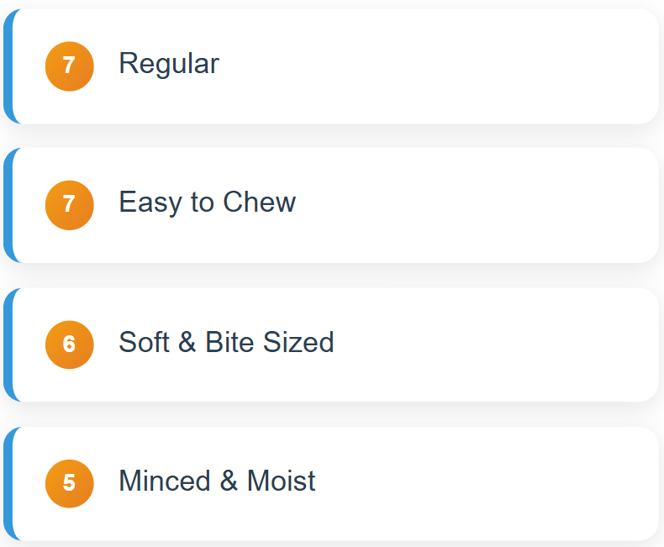
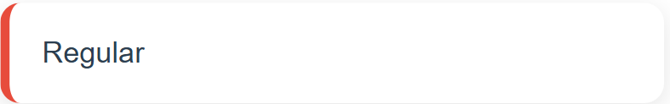
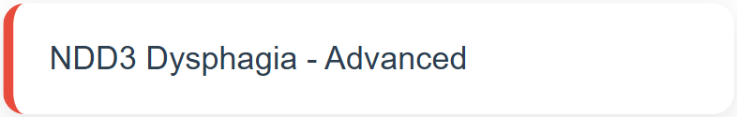
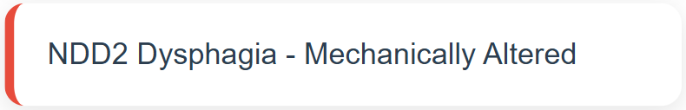
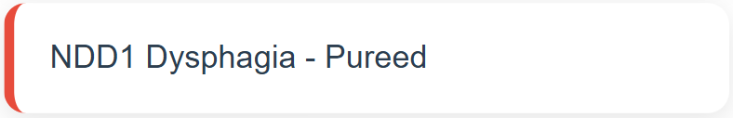
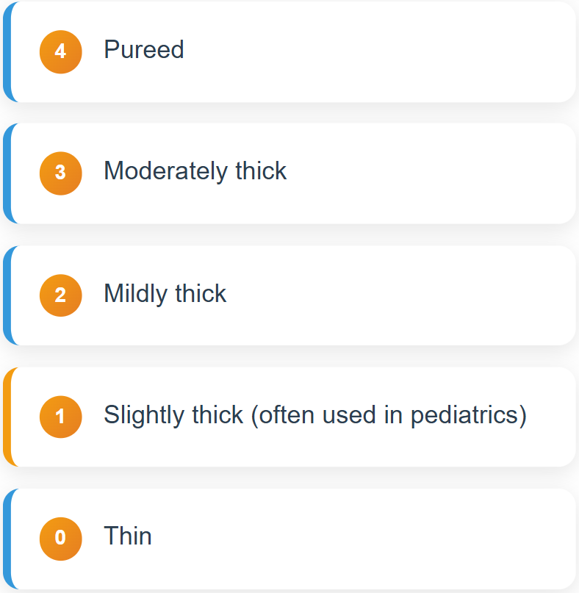


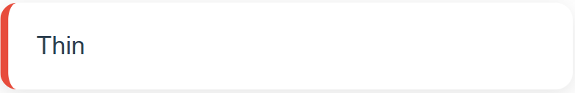
Dysphagia Diet Textures
Dysphagia diet texture terminology can vary by individual facility—although there are widespread efforts to shift from national standards (e.g., National Dysphagia Diet) to international standards (e.g., International Dysphagia Diet Standardisation Initiative or IDDSI).
-
Note: Level 1 (slightly thick liquids) is primarily used in pediatric cases and does not have a corresponding liquid texture in the National Dysphagia Diet.

Slide 21
The IDDSI Framework
The International Dysphagia Diet Standardisation Initiative (IDDSI) framework (https://www.iddsi.org/) is a global effort designed to avoid the confusion created by variable terminology and definitions to describe modified diets in locations around the world.
The goal is to improve safety and to ensure equitable care for diet modification for all individuals with dysphagia worldwide.

Slide 22
Thickened Liquids
Without instrumental swallowing assessments (e.g., VFSS/MBSS, FEES), we’re unable to determine if
  thickened liquids behave differently from thin liquids;
  aspiration occurs with any texture; or
  which strategies are most helpful for improving swallow efficiency and safety.

Slide 23
Thickened Liquids (cont’d)
Although using thickened liquids can help swallowing for some patients, it can also lead to problems—such as reduced fluid intake or other health issues if the patient aspirates the thickened liquids.
SLPs may recommend thickened liquids on an individualized basis.
  SLPs use all available information about the patient’s health—as well as current evidence on diet texture modifications and the patient’s preferences—to make informed recommendations and to obtain informed consent from the patient or decision maker.

Slide 24
Cognition, Speech, Language, and Voice
In addition to treating swallowing disorders, SLPs also work with individuals who have difficulties with cognition, speech, language, and voice.

Slide 25
Cognition
SLPs play a role in the screening, assessment, diagnosis, and treatment of people with cognitive difficulties.
Changes in thinking skills—including memory, attention, problem solving, and executive functioning—can result from a variety of conditions, including the following:
  stroke
  dementia
  delirium
  traumatic brain injury (TBI)
  concussion—also known as mild traumatic brain injury (mTBI)
  long COVID
  cancer-related cognitive changes
Cognitive treatment may be restorative (aiming to restore function and brain pathways), compensatory (e.g., environmental modifications, visual aids), and may involve patient and care partner education.

Slide 26
Speech
Speech disorders can be developmental or acquired and can include the following:
  dysarthria
  apraxia of speech
Speech disorders may co-occur with other conditions—like aphasia or cognitive deficits.
SLPs can help improve a person’s speech production and intelligibility through a variety of methods, including:
  strategies — modifying loudness, rate of speech
  prompts or cues — to improve accuracy or efficiency
  care partner training — to maximize communication effectiveness
  augmentative and alternative communication (AAC) — using gestures, communication boards, or electronic speech output devices, if indicated

Slide 27
Language
Neurological disorders as well as developmental, psychiatric, and medical conditions can cause changes to
  language production (expressive language) and
  understanding of language (receptive language).
Here are some examples of conditions that can cause language changes:
  stroke
  traumatic brain injury
  dementia
  multiple sclerosis
  intellectual disability

Slide 28
Language (cont’d)
SLPs help rehabilitate difficulties with language in the following ways:
  provide training on communication strategies
  help find the most effective method of communication (e.g., verbal, written, AAC)
  train care partners to incorporate skills learned in therapy to everyday life

Slide 29
Voice
A voice disorder a set of changes to voice quality, pitch, or loudness that
  does not align with the person’s age, gender, geographic location, or cultural background or
  impacts an individual’s ability to meet their daily needs.
Examples of voice disorders include the following:
  vocal fatigue
  structural changes to the vocal folds or voice box (larynx)
  spasmodic dysphonia
  muscle tension dysphonia

Slide 30
Aerodigestive Disorders
Aerodigestive disorders can cause secondary problems in feeding, swallowing, voice, and/or laryngeal airway function.
SLPs play a role in the screening, assessment, diagnosis, and treatment of these secondary problems.
SLPs often work collaboratively with other professionals (e.g., ear, nose, and throat [ENT] specialists) in serving individuals with aerodigestive disorders.
Examples of aerodigestive disorders inculde:
  muscle tension dysphonia
  muscle tension dysphagia
  paradoxical vocal fold movement (PVFM)
  chronic cough

Slide 31
When To Consult an SLP
Consult an SLP when a patient has an observed or reported difficulty with communication, cognition, or swallowing.
Use a referral guideline or a screening tool to identify instances when a comprehensive speech-language pathology evaluation may be indicated.
See this ASHA resource for more information:
  SLP Health Care Referral Guidelines

Slide 32
Additional Resources
Speech-Language Pathologists in Health Care Settings — ASHA’s webpage with resources for SLPs who work in health care settings.
ASHA Practice Portal — contains comprehensive information about evaluation and treatment considerations on topics including adult dysphagia, aphasia, acquired apraxia of speech, cultural responsiveness, dementia, dysarthria, head and neck cancer, telepractice, TBI, and voice disorders.
ASHA Evidence Maps — a searchable online tool designed to assist clinicians with making evidence-based decisions.
Flexible Endoscopic Evaluation of Swallowing — ASHA’s webpage that describes the instrumental assessment FEES.
Videofluoroscopic Swallow Study (VFSS) — ASHA’s webpage that describes the instrumental assessment VFSS/MBSS.
International Dysphagia Diet Standardisation Initiative —This webpage details the history behind—and ASHA’s support of—IDDSI.
Questions? Email healthservices@asha.org and let us know how we can support you.

Slide 33
References
Berg, R. L., Glurich, I., Panny, A., Scannapieco, F. A., Miecznikowski, J., VanWormer, J., & Acharya, A. (2023). Modeling longitudinal oral health status and pneumonia risk: Secondary data analyses of an integrated dental-medical cohort. BMC Oral Health, 23, 950. https://doi.org/10.1186/s12903-023-03629-0
Cichero, J. A., Lam, P., Steele, C. M., Hanson, B., Chen, J., Dantas, R. O., Duivestein, J., Kayashita, J., Lecko, C., Murray, J., Pillay, M., Riquelme, L., & Stanschus, S. (2017). Development of International Terminology and Definitions for Texture-Modified Foods and Thickened Fluids Used in Dysphagia Management: The IDDSI Framework. Dysphagia, 32(2), 293–314. https://doi.org/10.1007/s00455-016-9758-y
Garand, K. L., McCullough, G., Crary, M., Arvedson, J. C., & Dodrill, P. (2020). Assessment across the life span: The clinical swallow evaluation. American Journal of Speech-Language Pathology, 29(2S), 919–933. https://doi.org/10.1044/2020_AJSLP-19-00063
Kaneoka, A., Pisgena, J. M., Miloro, K. V., Lo, M., Saito, H., Riquelme, L. F., LaValley, M. P., & Langmore, S. E. (2015). Prevention of healthcare-associated pneumonia with oral care in individuals without mechanical ventilation: A systematic review and meta-analysis of randomized controlled trials. Infection Control and Hospital Epidemiology, 36(8), 899–906. https://doi.org/10.1017/ice.2015.77
Remijn, L., Sanchez, F., Heijnen, B. J., Windsor, C., & Speyer, R. (2022). Effects of oral health interventions in people with oropharyngeal dysphagia: A systematic review. Journal of Clinical Medicine, 11(12), 3521. https://doi.org/10.3390/jcm11123521
Sheffler, K. (2018). The power of a toothbrush. The ASHA Leader, 23(5), 50–57. https://doi.org/10.1044/leader.FTR1.23052018.50

